Slide 1
Appellate E-filing Presentation
August 31, 2021
Presenters:
Bridget Asay, Stris & Maher
Ben Battles - Vermont Solicitor General
Emily Wetherell - Deputy Clerk & Staff Attorney
Andy Stone, Odyssey Project Team Leader
Rachel Smith, VT AGO

Slide 2
Filing your appeal

Slide 3
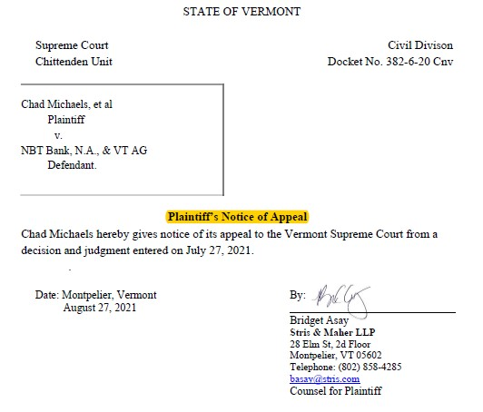

Slide 4
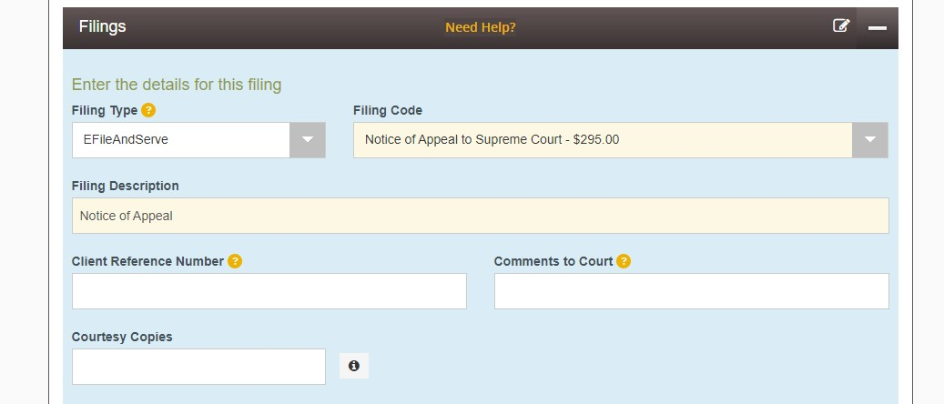

Slide 6
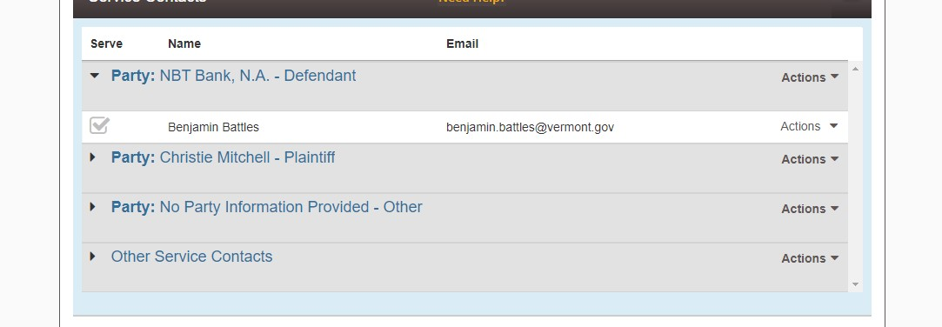

Slide 7
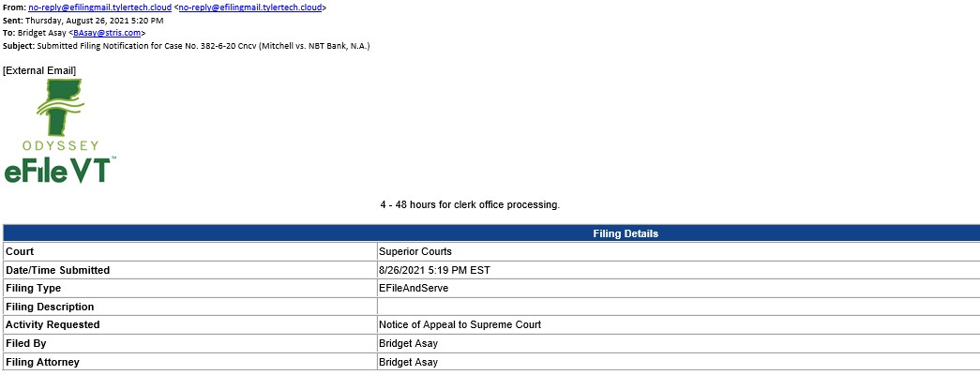
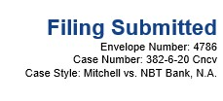

Slide 9
CLERK REVIEW

Slide 10
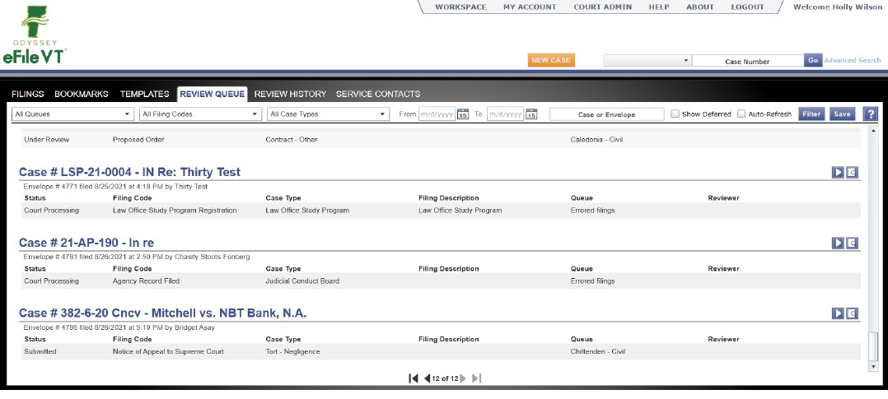

Slide 11
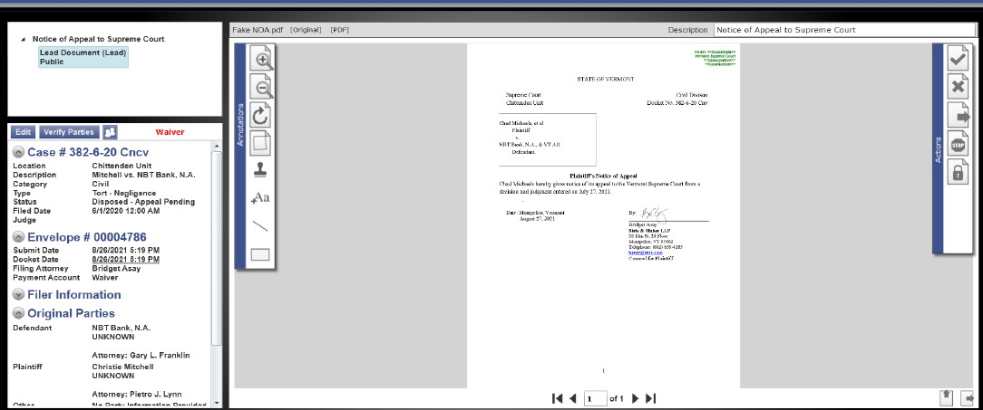

Slide 12
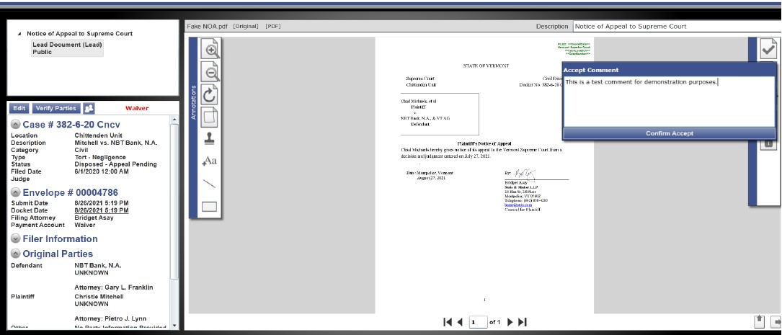

Slide 13
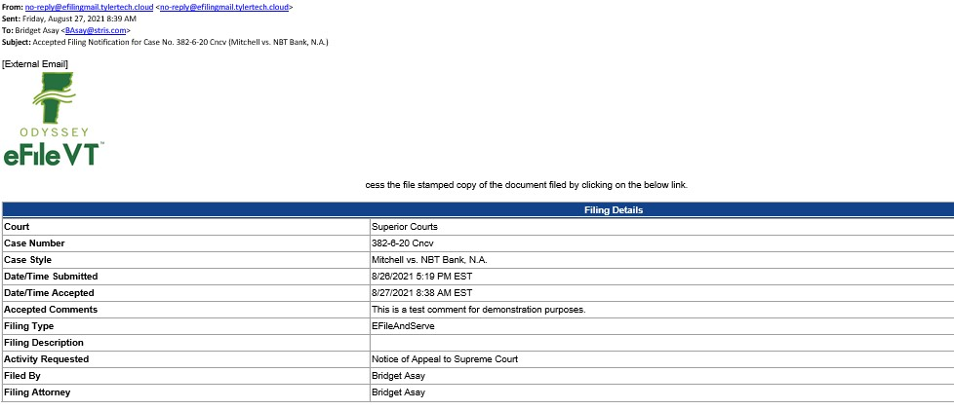
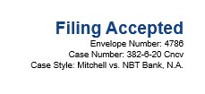

Slide 14
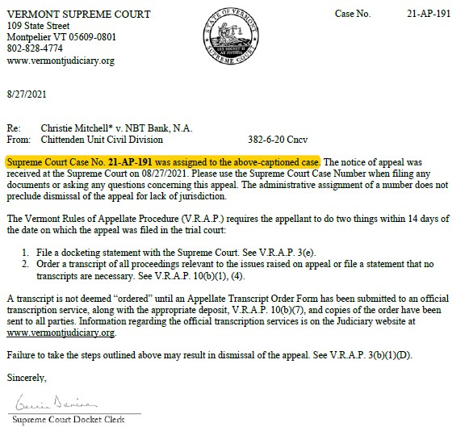

Slide 15
How to add yourself as a service contact
Log in to File & Serve
Under the “Actions” tab, go to “Service Contacts”
On Service Contacts page, click “Add Service Contact”
Fill in your contact information
Check the “Make this Contact Public” box to allow other users to easily add you as a service contact
Save Changes
Only add yourself as a service contact – do not add opposing counsel!

Slide 16
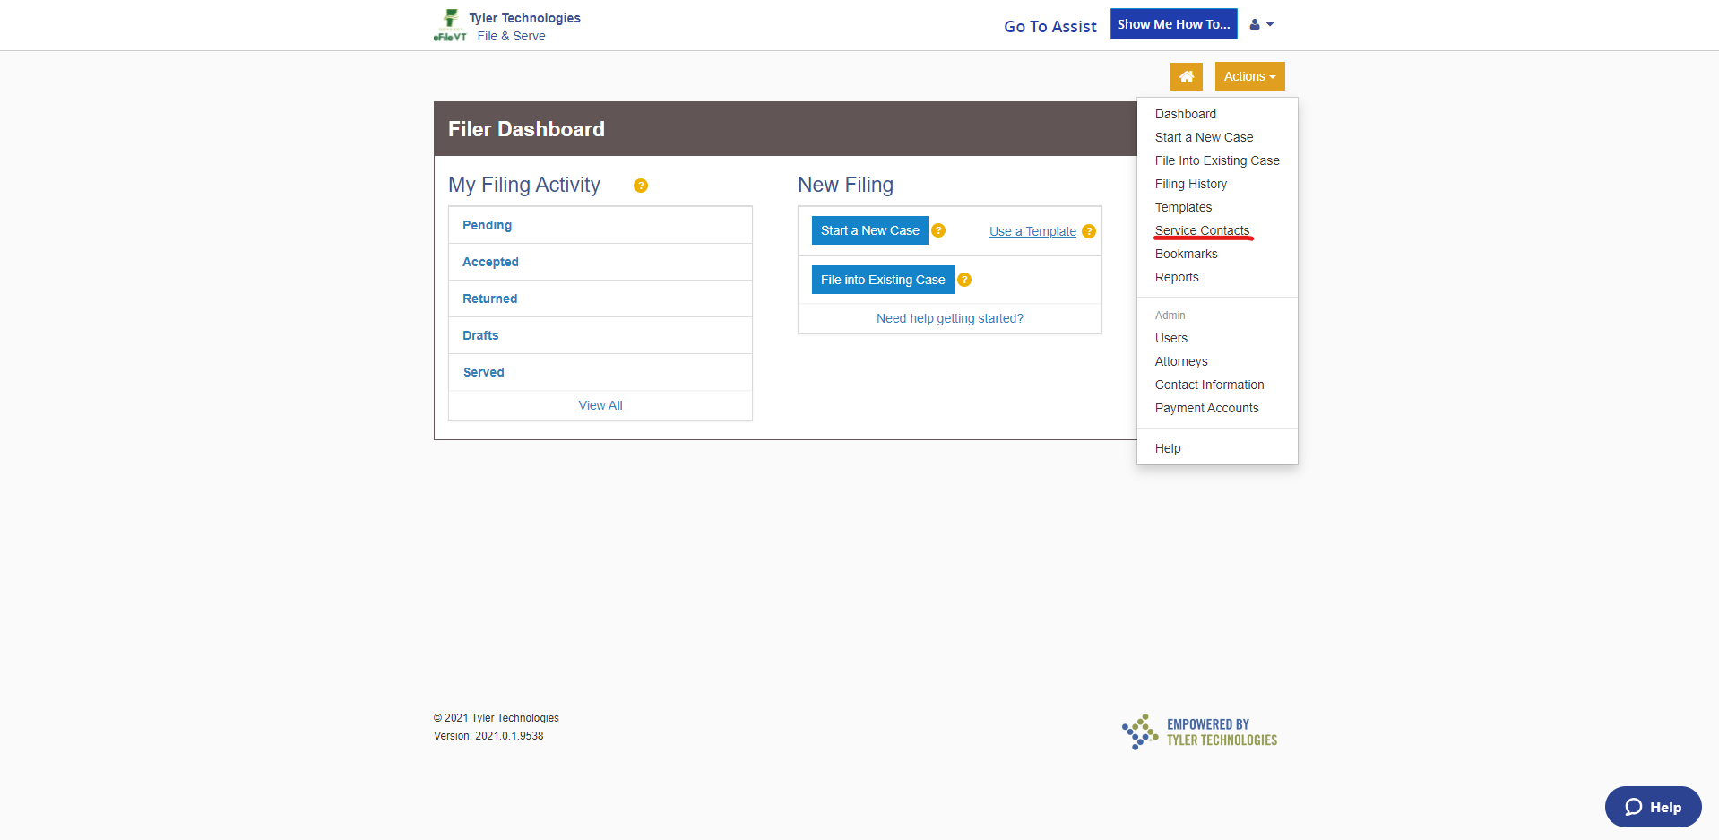

Slide 17
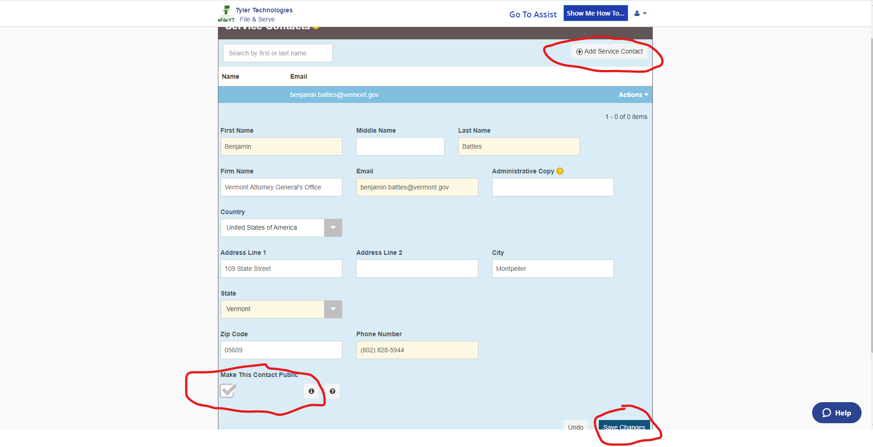

Slide 18
THe RECORD ON APPEAL

Slide 19
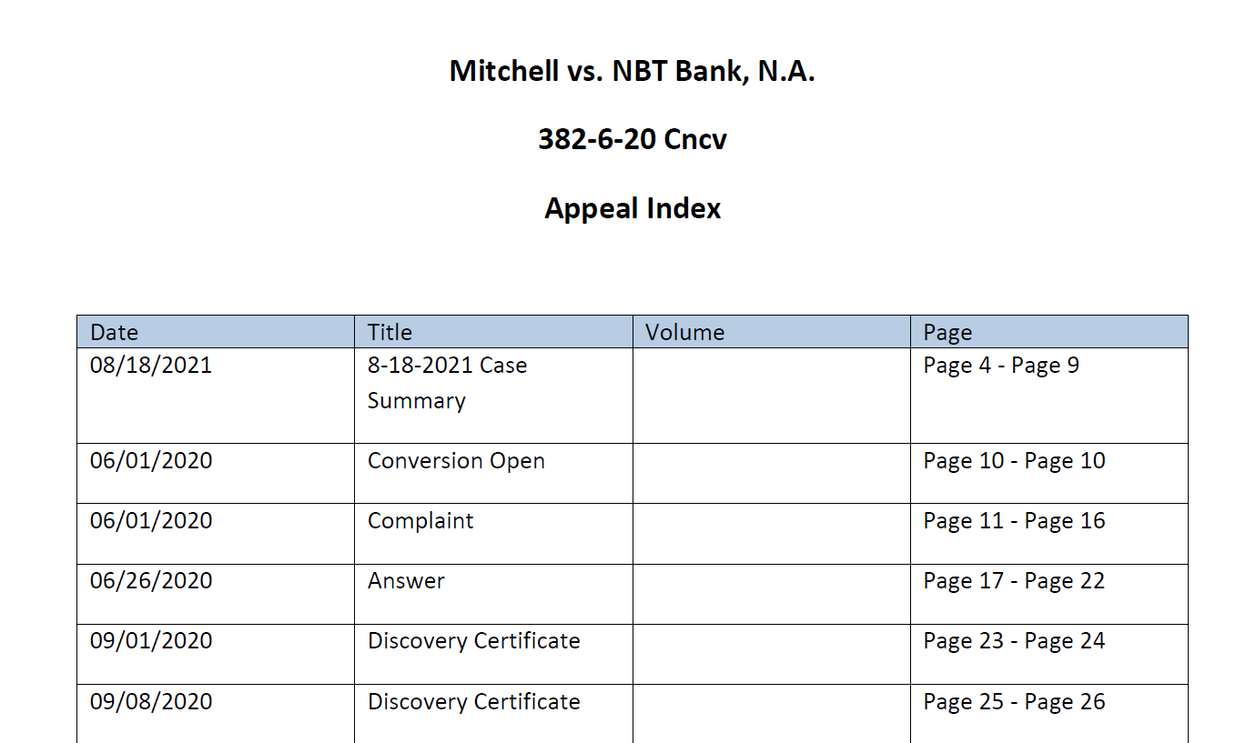
Appeal Volume
Supreme Court docket clerk must create with 14 days of opening appeal
Contains all PDF documents in the trial court case
Must be cited to in appellate briefs

Slide 20
Appeal Volume on the Portal
The appeal volume appears on the portal for both the trial court and appellate cases

Slide 21
What to do if the electronic Appeal Volume is missing documents?
Confirm the missing documents are part of the record on appeal.
If the documents were filed by hard copy in the trial court before the trial court transitioned to electronic filing, you can file the missing documents as part of a Printed Case.
If the documents were filed electronically in the trial court, you should first call the Supreme Court docketing clerk and notify them of the missing documents.
Audio or video files (e.g., trial exhibits) will not be in the Appeal Volume. Attorneys should confirm with the Supreme Court that it has received these documents from the trial court.

Slide 22
FILING A MOTION

Slide 23
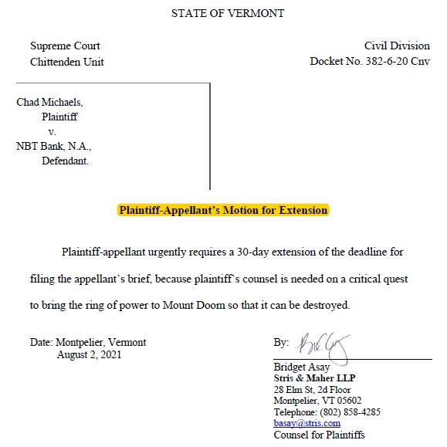

Slide 24
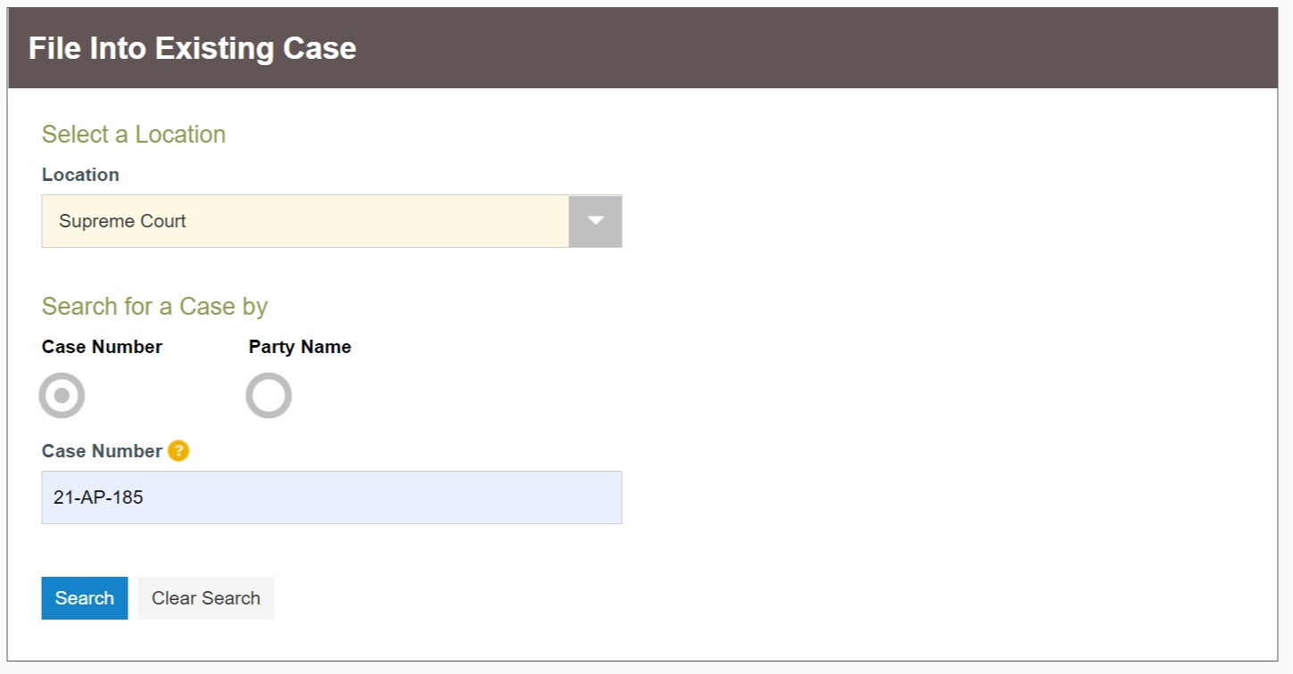

Slide 26
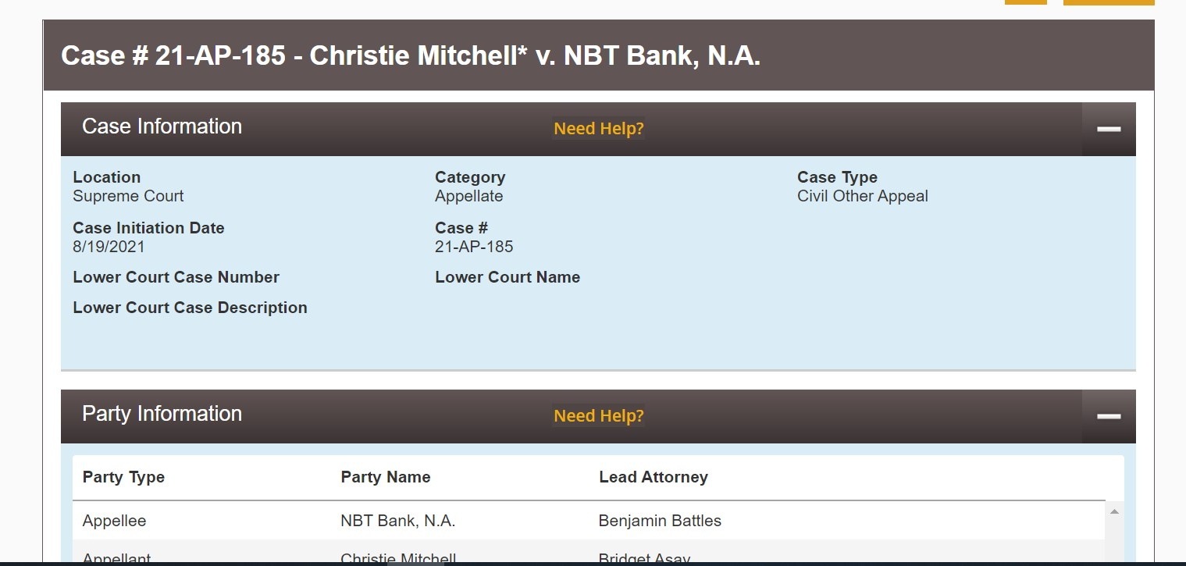

Slide 27
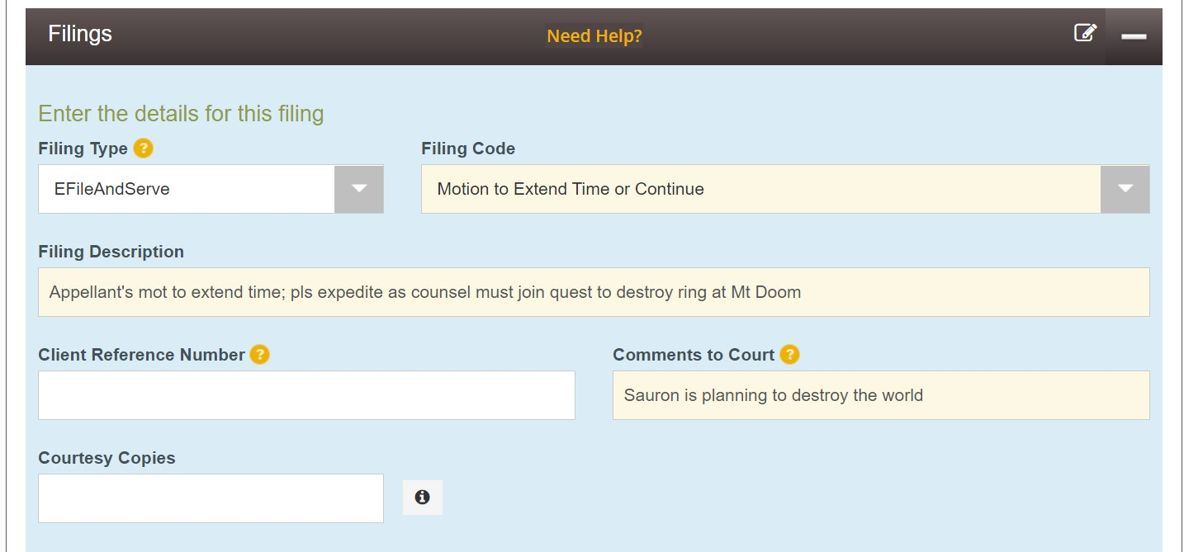

Slide 28
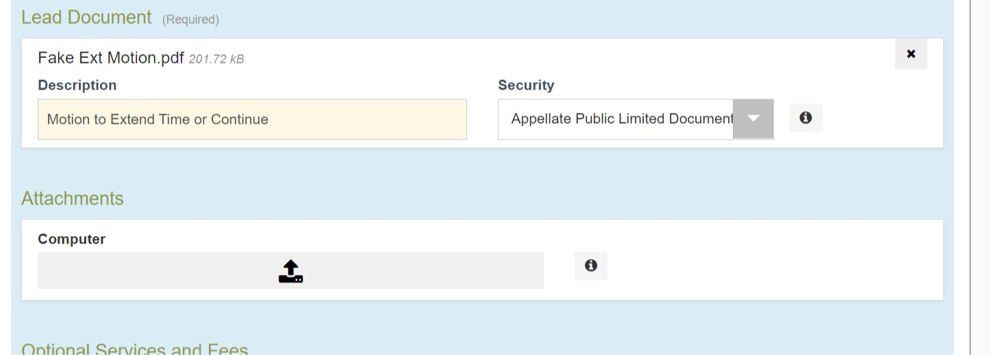

Slide 30
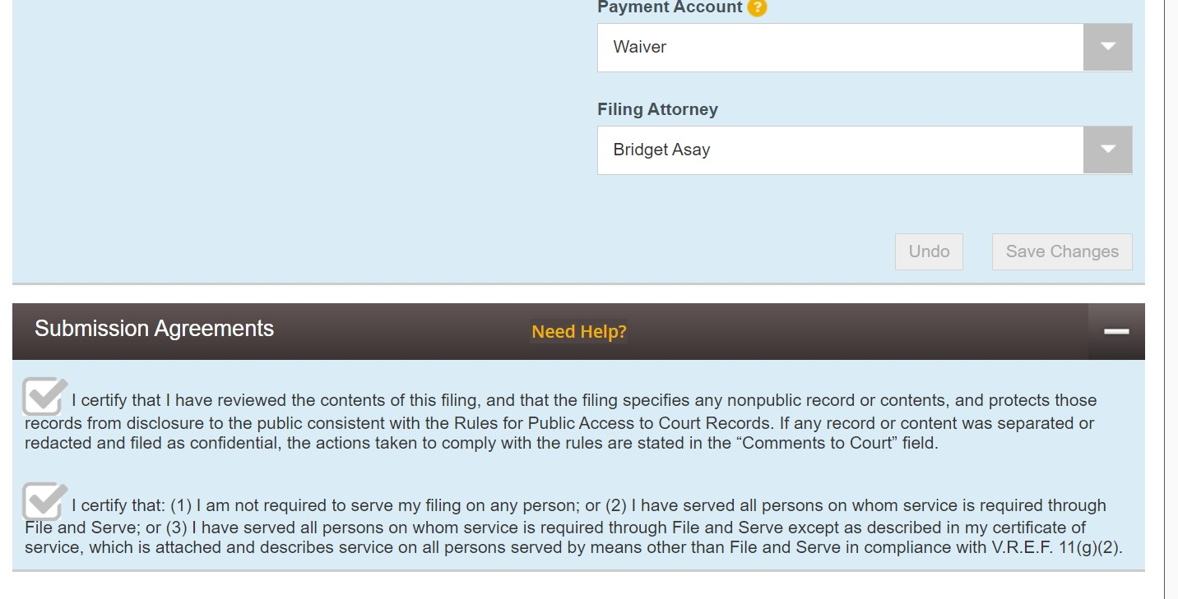

Slide 31
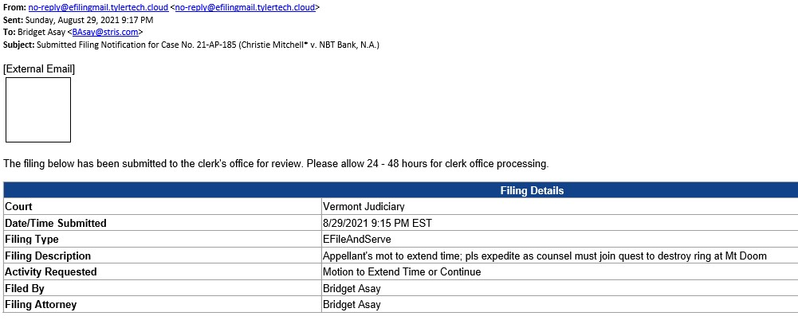
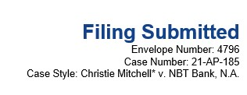

Slide 32
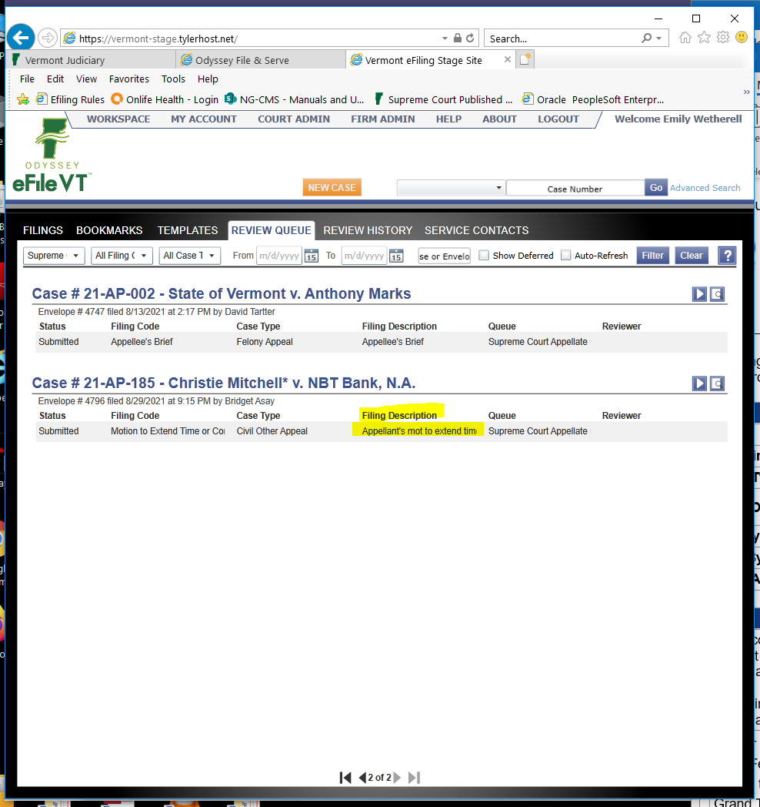

Slide 33
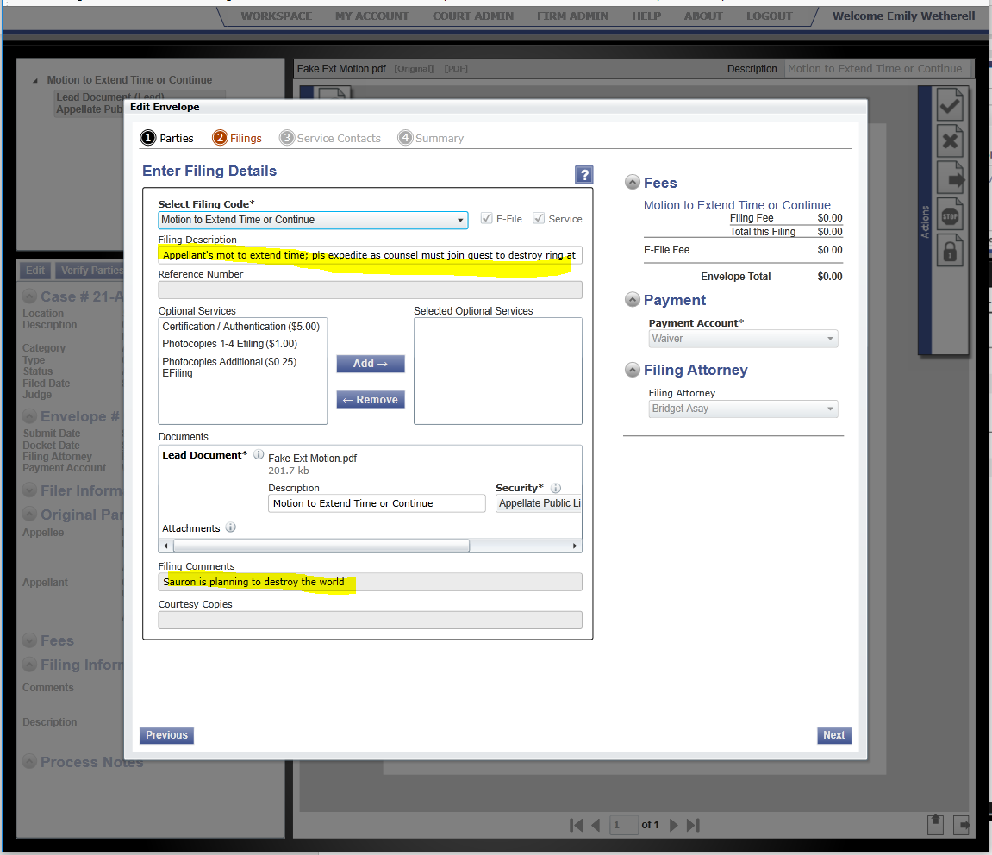

Slide 34
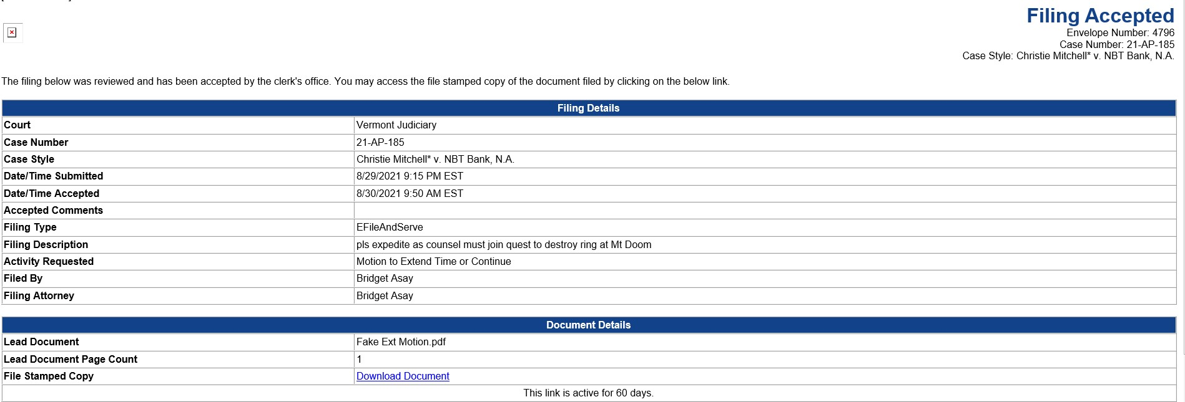

Slide 35
Tips for your e-filed brief
Justices are probably reading your brief on a screen. No paper copies!
New formatting requirements: 13-point font, 1.2 spacing. No color covers.
Record cites must be to page numbers of the appeal volume. Parallel cite to optional printed case if you file one.
Make it easy to find page numbers in the PDFs of your briefs and printed cases.
Remember that hyperlinks will not work in a flattened PDF. There’s no rule against submitting a regular PDF of your brief by email.
Filed briefs will be accessible to the public through the public portal.

Slide 36
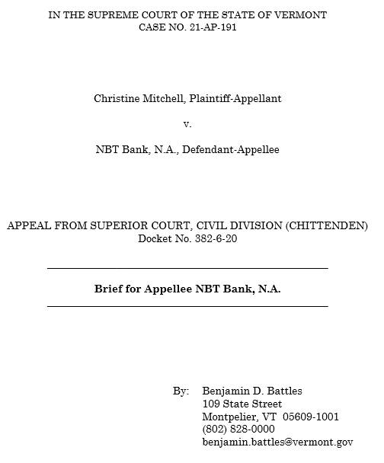

Slide 37
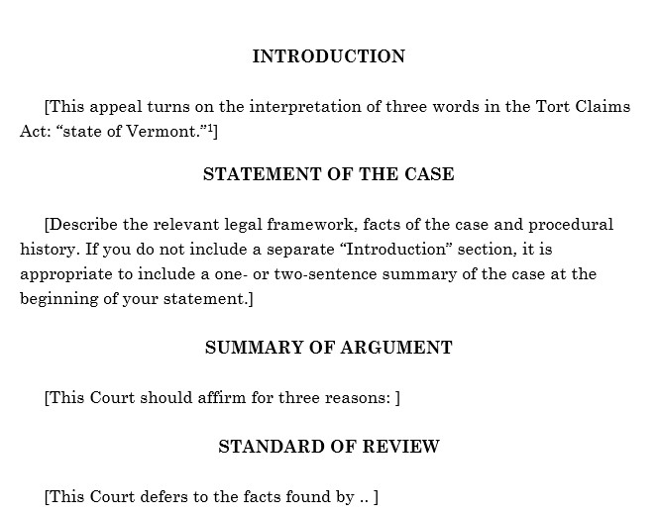

Slide 38
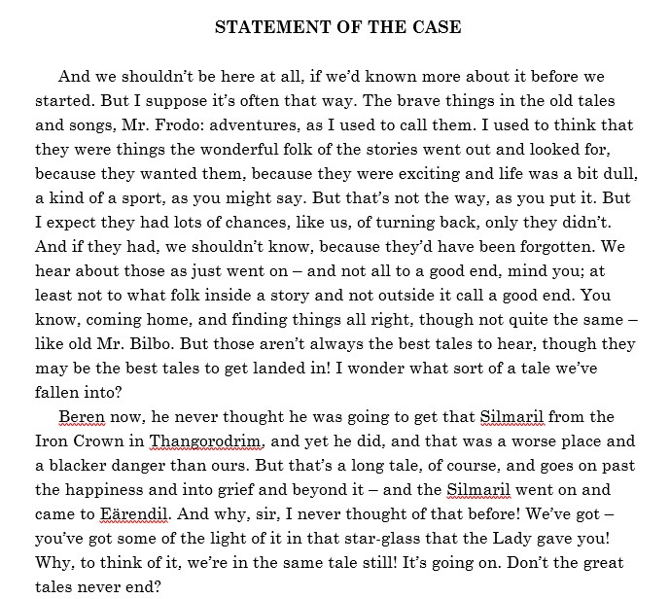

Slide 39
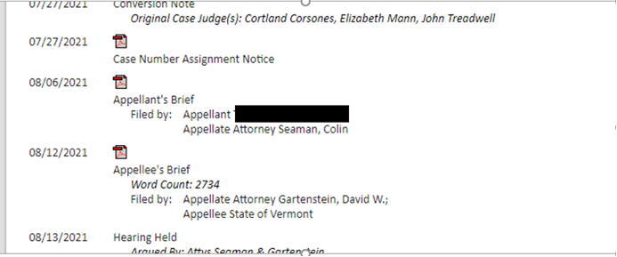
Accessing Briefs on the Portal

Slide 40
The (usually) optional printed case
Still required in certain agency appeals.
Optional in other cases.
May be helpful if the appeal volume is very large.
Because every document is in the appeal volume, you can file a targeted printed case with a few key documents.
Build the printed case PDF using the appeal volume, so that the appeal volume page numbers carry over.

Slide 41
Support for Filers
Specific questions about e-Filing process from filers-
email Jud.efileSupport@vermont.gov
For general information, see the Electronic Filing page on the Judiciary website
https://www.vermontjudiciary.org/about-vermont-judiciary/electronic-access/electronic-filing
The Supreme Court efiler user guide is available there
https://www.vermontjudiciary.org/sites/default/files/documents/VERMONT%20SUPREME%20COURT%20OFS%20FILER%20GUIDE%20v1.pdf

Slide 42
Resources

